Slide 1




Social, demographic, and socioeconomic attributes of persons with multiple sclerosis experiencing diminished mental health
Emily Tyszka, MPH(c); Farren Briggs, PhD, ScM
Case Western Reserve University

Slide 2

Presenter Disclosure:
The presenters have no disclosures to report

Slide 3
Background:
Multiple sclerosis (MS) affects mental health, including emotional well-being and mood.¹ The lifetime prevalence of depression and anxiety among persons with MS (PwMS) is 1.8 and 1.5 times that of people without MS.²
Psychiatric and mental health conditions are associated with decreased adherence to treatment, functional status, and quality of life in PwMS.³
In the general population, several factors have been reported to confer risk for poor mental health outcomes and psychiatric disorders, including sex, race, age, socioeconomic status (SES), social support, and marital status.⁴
However, the extent to which such factors contribute to the mental health status of PwMS remains understudied.
1. Paparrigopoulos, International Review of Psychiatry, 2010. 2. Marrie, Neurology, 2015. 3. Chwastiak, Psychiatric Clinics of North America, 2007. 4. Silva, The European Journal of Psychiatry, 2016.

Slide 4
Objective:
To characterize the sociodemographic attributes of persons with MS experiencing diminished mental health.
The study included 2,342 PwMS who participated in iConquerMS™ between 11/20214 and 9/2020. All respondents were U.S. residents.
The outcome was respondents’ answer to the question “In general, how would you rate your mental health, including your mood and ability to think? (Excellent=0; Poor=4)”, asked as part of the PROMIS© Global-10 Survey.
The independent variables of age, sex, race, education, employment status, marital status, living alone / with others, insurance payer, and MS healthcare provider were investigated using ordinal logistic regression models. Exploratory sex-stratified models were also conducted.
Study Population:
Study Design:

Slide 5
Variables Investigated:
OUTCOME: In general, how would you rate your mental health, including your mood and ability to think? (Excellent=0, Very Good=1, Good=2, Fair=3, Poor=4)
PREDICTORS:
Age: Years
Sex: Female=0, Male=1
Race: White=0, Black=1, Other/Multiracial=2
MS Subtype: Relapsing Remitting=0, Secondary Progressive=1, Primary Progressive=2, Clinically/Radiologically Isolated Syndrome=3, Not available=4
Highest level of educational attainment: Graduate Degree=0, Bachelor’s Degree=1, Associate Degree / Some College=2, High School or less=3
Marital status: Married / Cohabitating=0, Divorced / Separated=1, Widowed=2, Never Married=3, Prefer Not To Say=4
Insurance payer: Private=0, Medicare / Medicaid=1, VA=2, Multi-payer=3, Other / Not Available =4
Living alone / with others: Live with Others=0, Live Alone=1, No Answer=2
Employment status: Employed=0, Unemployed=1, Retired/Not Looking=2, Student=3, Disabled=4, Prefer Not To Say=5
MS healthcare provider: Neurologist / MS Specialist=0, General Practitioner=1, No Provider / Other=2

Slide 6
Results:
 | “In general, how would you rate your mental health, including your mood and ability to think?”
 | Excellent | Very Good | Good | Fair | Poor | Total
N | 128 | 535 | 765 | 679 | 235 | 2342
Race (%)
White | 117 (91.4) | 485 (90.7) | 699 (91.4) | 628 (92.5) | 223 (94.9) | 2152 (91.9)
Black | 3 (2.3) | 18 (3.4) | 26 (3.4) | 13 (1.9) | 3 (1.3) | 63 (2.7)
Other | 8 (6.2) | 32 (6.0) | 40 (5.2) | 38 (5.6) | 9 (3.8) | 127 (5.4)
Male (%) | 23 (18.0) | 106 (19.9) | 142 (18.6) | 146 (21.6) | 59 (25.2) | 476 (20.4)
Subtype (%)
RR | 71 (62.3) | 291 (59.8) | 445 (62.4) | 390 (61.4) | 124 (55.9) | 1321 (60.8)
SP | 24 (21.1) | 102 (20.9) | 159 (22.3) | 119 (18.7) | 38 (17.1) | 442 (20.4)
PP | 13 (11.4) | 65 (13.3) | 63 (8.8) | 76 (12.0) | 39 (17.6) | 256 (11.8)
CIS/RIS | 1 (0.9) | 11 (2.3) | 31 (4.3) | 34 (5.4) | 14 (6.3) | 91 (4.2)
NA | 5 (4.4) | 18 (3.7) | 15 (2.1) | 16 (2.5) | 7 (3.2) | 61 (2.8)
Mean age (SD) | 47.58 (11.26) | 50.35 (11.49) | 50.96 (11.19) | 52.08 (11.64) | 53.94 (13.02) | 51.26 (11.66)
Study Population Characteristics
The study sample was 92% non-Hispanic white and 20% male.
The frequencies of MS subtypes were 61% relapsing remitting (RR), 20% secondary progressive (SP), and 4% clinically / radiologically isolated syndrome (CIS/RIS).
The mean age at survey completion was 51.3 years.
Table 1: Study population characteristics, stratified by self-reported mental health status.

Slide 7
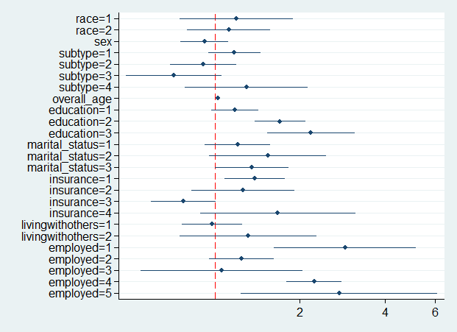
Results 1:
Multivariable Ordered Logistic Regression Model
Respondents’ age, education level, marital status, insurance provider, and employment status were associated with mental health status.
No associations were found for sex, race, MS subtype, healthcare provider type, or living alone / with others in this multivariable model.
Figure 1: Forest plot summary of associations between sociodemographic attributes and self-reported mental health

Slide 8
Results 1:
Age. A year increase in age was associated with a 3% increased odds of lower mental health (p=1.2×10⁻⁹).
Education. PwMS with at most a high school (OR=2.1, p=1.3×10⁻⁵) or some college (OR=1.7, p= 5×10⁻⁷) reported lower mental health than those with graduate education.
Marital Status. Those who were never married (OR=1.4, p=0.05) had lower mental health than those partnered.
Employment. PwMS who were unemployed (OR=2.9, p=3.3×10⁻⁴) or disabled (2.2, p=2.1×10⁻¹²) were found to have lower mental health than the employed.
Insurance. PwMS on public insurance (Medicaid, Medicare) had lower mental health than those with private insurance (OR=1.4, p=0.01).

Slide 9
Results 2: Including HealthCare Provider
Among the 879 PwMS who reported their MS healthcare provider, those receiving their MS care from a General Practitioner had 2.4 times increased odds of lower mental health than those receiving care from a Neurologist or MS Specialist (p=0.02), even after adjusting for other sociodemographic attributes.
Results 3: Sex-stratified Analyses
Women (N=1835)
Older age, lower education, having public or military insurance, being unemployed or disabled, and being widowed or never married, were associated with lower mental health.
Men (N=440)
Lower education and being unemployed or disabled were associated with lower mental health.
Age and marital status were not associated, while military (5.5%) and multi-payer (16%) recipients reported better mental health.

Slide 10
Conclusions
Ordinal logistic regression demonstrated independent associations for several sociodemographic attributes and mental health in PwMS.
There were associations for age, education, marital status, insurance payer, and employment status, and most interestingly, MS healthcare provider in the total population.
There were sex-differences in the associations for marital status and insurance payer on mental health in PwMS
These results point to the influence of sociodemographic attributes in the mental health of persons with MS, which can inform risk stratification models for reducing poor mental health outcomes in PwMS.
Future research will need to focus on racial minorities populations with MS in order to determine the extent to which these attributes contribute to mental health status in these groups as the available sample was modest.

